Slide 1

Itinerary optimization for multi locations travel using Machine Learning (XGBoost) and Genetic algorithm
Md Touhid Hossain
May 16, 2022

Slide 2
The Problem
It might seem like the best route around a series of stops is simply the shortest route. But an optimal itinerary can be one of the followings:
Take the least time.
Uses the smallest number of vehicles.
Costs the least money.
Minimizes fuel use or carbon emissions.
Or, yes, covers the shortest distance.
So, “shortest” is not always the “best”!
In the real world we travel along roads, not in straight lines. And roads come with traffic, bridges, tunnels, tolls, one-way sections, speed limits, parking restrictions, and many other factors that affect how suitable they are for traveling and stopping.
With 10 destinations, there can be more than 300,000 ways to connect them all.

Slide 3
Objective
Finding Optimized Itinerary for a multi location travel (based on time)
Implementation Steps
Predicting travel time between two locations using historical travel data
Having multiple locations with known spatial data (latitudes and longitudes), find out the optimal travel path (least time to complete a loop)
DATA
PREDICTION
MODEL
OPTIMIZATION

Slide 4
Explaining the Data
The data set is selected from Kaggle dataset ‘New York City Taxi Trip Duration’
It’s a 2016 Taxi Trip data with the following 11 data fields:
Data fields
id - a unique identifier for each trip
vendor_id - a code indicating the provider associated with the trip record
pickup_datetime - date and time when the meter was engaged
dropoff_datetime - date and time when the meter was disengaged
passenger_count - the number of passengers in the vehicle (driver entered value)
pickup_longitude - the longitude where the meter was engaged
pickup_latitude - the latitude where the meter was engaged
dropoff_longitude - the longitude where the meter was disengaged
dropoff_latitude - the latitude where the meter was disengaged
store_and_fwd_flag - This flag indicates whether the trip record was held in vehicle memory before sending to the vendor because the vehicle did not have a connection to the server - Y=store and forward; N=not a store and forward trip
trip_duration - duration of the trip in seconds

Slide 5
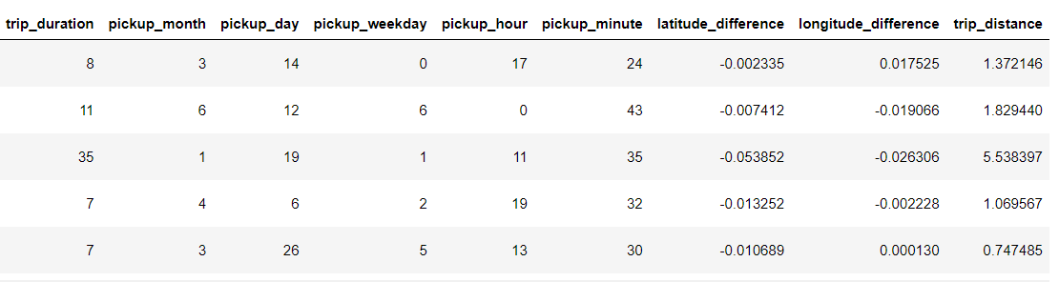
Data Processing
Since each location’s coordinates are given in the dataset, Manhattan distances are calculated between each pair of points
The longitude and latitude differences were found to get a sense of direction (East to West, North to South)
Constructed other variables, like month, date, etc.
Converted duration to minutes for easier interpretation

Slide 6
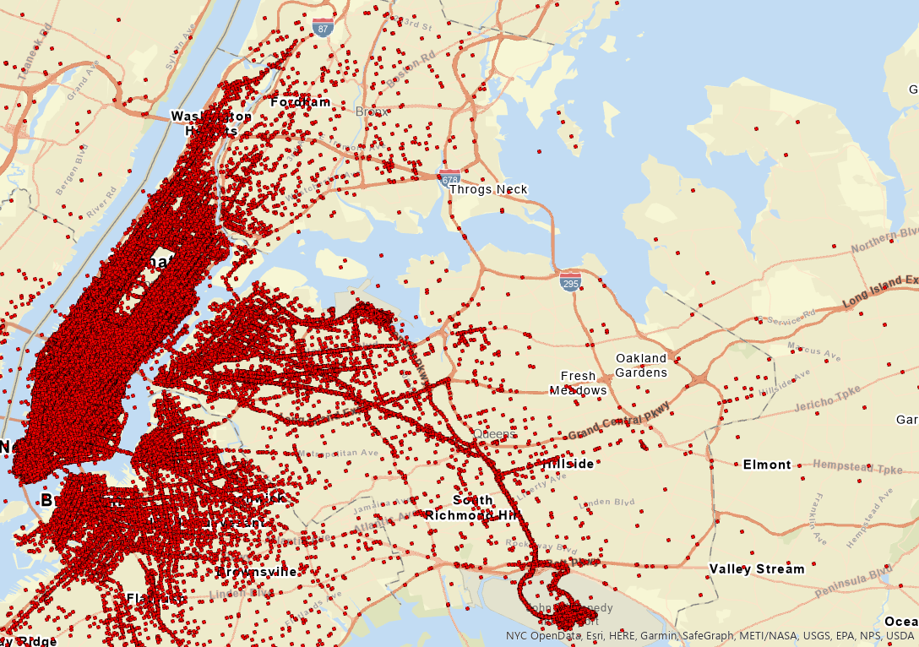
Prediction Model selection based on Dataset
A quick preliminary check on the map using ArcGIS shows that some drop off locations are in Canada, in the Pacific Ocean, or on the Ellis Island (Statue of Liberty), where cars simply don’t go.
Removing these points is quite a difficult task without built-in geo-oriented packages, but we can also leave them in the data, since some machine learning models can deal very well with outliers.
Using a simple linear regression won’t produce expected results with the type of data and goals.
With a few random outliers in a huge data set, possibly extraneous features which came with it, we can try a tree-based model.

Slide 7
Extreme Gradient Boosting (XGBoost)
Gradient boosting refers to a class of ensemble machine learning algorithms that can be used for classification or regression predictive modeling problems.
Ensembles are constructed from decision tree models. Trees are added one at a time to the ensemble and fit to correct the prediction errors made by prior models. This is a type of ensemble machine learning model referred to as boosting.
Extreme Gradient Boosting, or XGBoost for short, is an efficient open-source implementation of the gradient boosting algorithm.
The two main reasons to use XGBoost are execution speed and model performance.
XGBoost dominates structured or tabular datasets on classification and regression predictive modeling problems.
So, XGBoost model is chosen as the prediction model.

Slide 8
Prediction Model Parameters and Training
Took root mean squared logarithmic error (RMSLE) as the evaluation metric, since it reduces error magnitude. With RMSLE, we can run different parameters for tree depth and learning rate and compare the results.
#XGBoost parameters
params = {
'booster': 'gbtree',
'objective': 'reg:linear',
'learning_rate': 0.05,
'max_depth': 14,
'subsample': 0.9,
'colsample_bytree': 0.7,
'colsample_bylevel': 0.7,
'silent': 1,
'feval': 'rmsle'
}
#Train model
gbm = xgb.train(params,
dtrain,
num_boost_round = nrounds,
evals = watchlist,
verbose_eval = True
)

Slide 9
Optimization With Genetic Algorithm
Machine learning part is only the first step of the project.
Once the model is trained and saved, genetic algorithm is used for optimization
In the genetic algorithm a population of candidate solutions to an optimization problem is evolved toward better solutions, and each candidate solution has a set of properties which can be mutated and altered.
Basically, it start with a random solution to the problem and try to “evolve” the solution based on some fitness metric.
The result is not guaranteed to be the best solution possible, but it should be close enough.

Slide 10
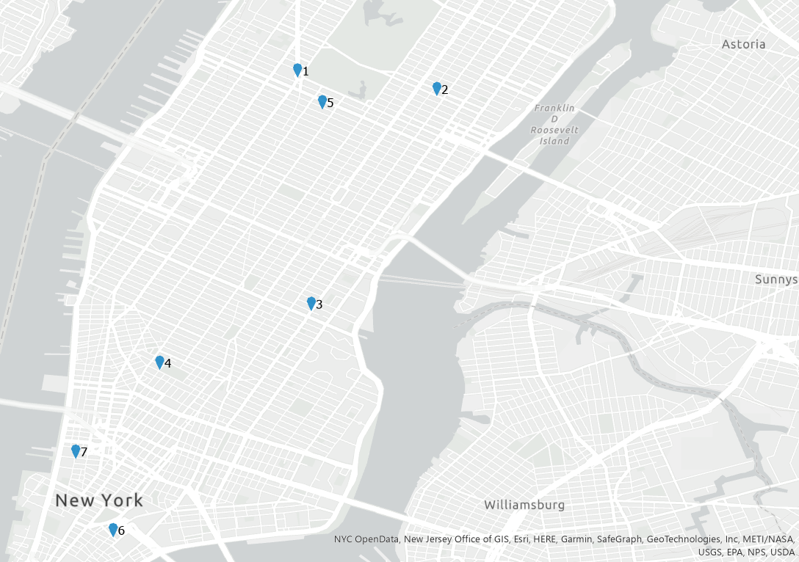
A Test problem with 7 random locations in NYC
Let’s say we have 7 points on the map.
We would like a delivery truck to visit all these locations on the same day, and we want to know the best route.
However, we don’t know how long it will take the driver to go between each point because we don’t have the data for all address combinations.
With our predictive model, we can find out how long it will take for a truck to get from one point to another, and we can make predictions for each pair of points.

Slide 11
Optimal Travel Path
At first, it starts with is a random visit order for each point.
Based on the fitness score being the shortest total time traveled, the algorithm attempts to find a better visit order, getting predictions from the machine learning model.
This process repeats until we figure out a close to ideal solution.
Start
Optimal path: L6> L7> L4> L1>L5>L2>L3>L6
(Travel time: 59 minutes)

Slide 12
Conclusions
Found a demo solution with random locations
The solution is not the exact route planner—it suggests a visit order
In future, it is possible to incorporate Google Maps API and plan out the exact pathing between each pair of points.
Also, weather data, time of the day and other factors affecting travel time can be incorporated in the model. This will require a different approach to constructing the input space altogether
This can be the starting for a full scaled route planning project

Slide 13

Questions/Discussion

